Slide 1


Ecat Test Application
Presented By:
Azhar Hayat (2021-CS-537)
Zargham Elahi (2021-CS-518)
Tuba Faryal (2021-CS-515)
Zainab Atif (2021-CS-551)
Amna Choudhri (2021-CS-513)
Presented To:
Fatima Shehzadi
Date submitted: December 23, 2022
Department of Computer Science
University of Engineering &Technology,
Lahore (Narowal Campus)

Slide 2
Agenda Of Presentation
Theme .
Existing system analysis.
Hardware requirements.
Software requirements.
Implementation.
Program flowcharts.
Literature review.
Conclusion.
Bibliography.

Slide 3
Theme
The proposed theme is to design the ECAT test application to conduct the entry test for the university.
The student will enter his data inside the system.
Then select the course from the given option .
Then start the test.
After completing the test student can check his detail result in result section.

Slide 4
Existing system analysis
To over come the following deficiencies in the existing system following system is presented:
Not user-friendly
Complex GUI
Slow processing speed

Slide 5
Hardware & Software Requirements
Hardware Requirements:
No special hardware is required for the application however some basic hardware of computer is required.
Software Requirements:
Following are the software requirement for the system:
Programming language | Assembly language
Software | Emu 8086
Operating system | Windows
Memory | 1 MB

Slide 6
Program Flowcharts
Flow chart define the flow of data in the source code.
Following table show the symbols terminology:
START/END
PROCESSES
DECISION MAKING
INPUT/OUTPUT

Slide 7
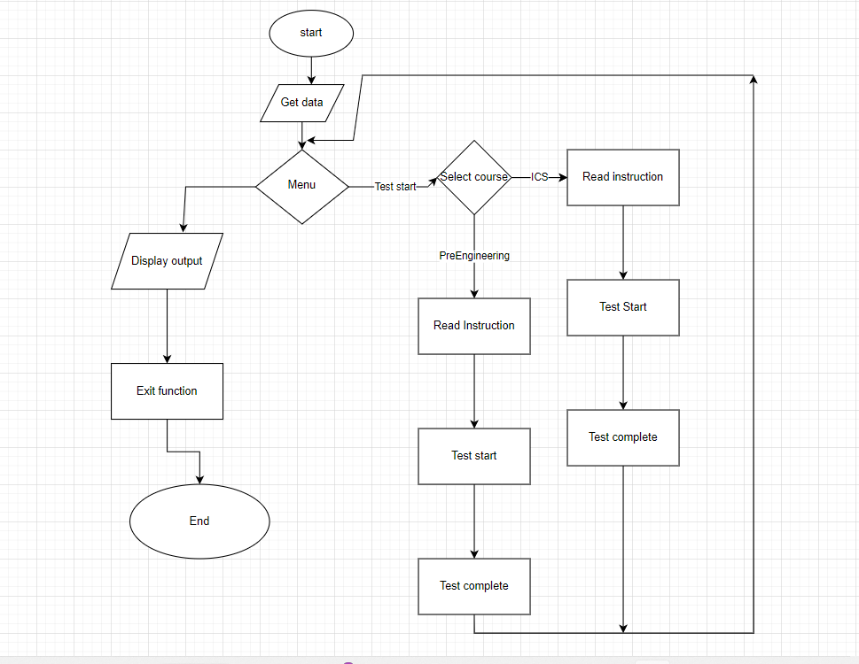
Flowchart

Slide 8
Implementation
The proposed project is design to conduct the entry test for the University of Engineering and technology Lahore.
The project contain the following modules:
Start Test
Check result
Exit
The program have the following function:
Get data()
Newline ()
The aim of the function is to get student data such as the Name, roll number etc.
On entering the choice it will run the different function however we have to start the test first in order to check the result else it will generate the Null or garbage values.

Slide 9
Literature Review
The review of the literature reveals that our presented application will help the student to focus on the test instead of the getting confused with user interface.

Slide 10
Conclusion
The main focus of the project is to improve the system interface with this new system.
All the objective have been achieved successfully expect the database.
As the assembly language does support the database efficiently.
So this run base application.

Slide 11


Slide 12
Bibliography
Assembly language for x8086 Processors by kip Irvine .
https://www.diagrams.net.com

